Slide 1
BANA 5205 – Team Final Project
Group 6
Hua Yang
Isaac Kim
John Giachinta
Joseph Morante
Patrick Strauss
Yuanchun Li

Slide 2
Table of Contents
Problem Statement
High-level approach to our research analysis
Exploratory analysis output
Model development output
Conclusion
1
2
3
4
5

Slide 3
Reminder: Problem Statement
Yuanchun, Hua, Isaac
Research Problem
Bike-sharing services encounter a multitude of variables that can ultimately impact/influence customer usage patterns (e.g., time of day, location, seasonality/weather, etc.). Therefore, it is incredibly important for these companies to be able to deeply understand how to navigate through these factors to enhance their overall strategic decision-making and operational efficiency.
The research problem our team intends to solve is predicting the demand for bike-sharing services at the busiest locations (per day) so that we can determine how to best optimize the allocation resources in the future based on historical data.
What are the high-level implications of this problem statement?
Operational Efficiencies
Resource Optimization
Navigating Complexity
Allows bike-sharing companies to become more aligned when it comes to their broader operational logistics
E.g., inventory management, maintenance scheduling, etc.
Also has downstream impacts from a resource optimization perspective
By truly understanding demand patterns, bike-sharing firms can more effectively / accurately allocate their resources
E.g., focusing more on maintaining bikes in higher-usage areas
Can lead to effects including reduced downtimes, higher usage rates, etc.
Allows bike-sharing companies to generally do a much better job of navigating through complexity
E.g., time of day, weather and seasonality can all have material impacts
Provides bike-sharing companies to better understand and plan for these variables

Slide 4
High-Level Approach of Our Research Analysis
Yuanchun, Hua, Isaac
High-Level Rationale
Underlying Methodologies Used
Before applying various statistical models to our underlying dataset, our group first performed an initial exploratory analysis and identified the following key trends:
There is a significant amount of total trips across a rather broad network of stations (pg. 5)
Average bike usage typically peaks during the morning and evening commute hours and is the highest overall in summer and Autumn (pg. 6)
Average trip duration for customers far outweighs trip duration for subscribers (pg. 7)
Based on the output of our initial exploratory analysis, our preliminary findings ultimately led us to perform a deeper dive using the following methods as outlined on the RHS of this slide
Method
1
Multinomial Logit Model Output
Used for modeling outcomes where the DV typically has discrete / non-ordered columns
Estimates the probability of an event occurring
Method
2
Exponential Smoothing / Holt-Winters Output
Time-series data forecasting analysis
Data analysis to show broader trends, seasonal patterns, etc.
Method
3
Normal Distribution Capacity Optimization
Assumption of a normally distributed dataset
Used to optimize capacity / resource allocation

Slide 5
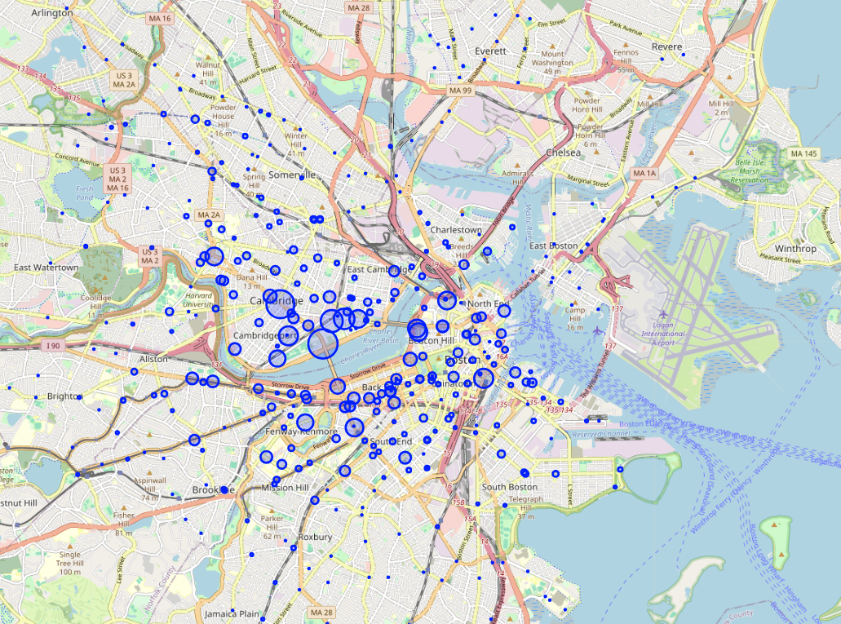
Yuanchun, Hua, Isaac
Exploratory Analysis / Summary Statistics – 1/5
Amount of trips per station (2019-2020)
Descriptive Statistics
Total Stations | 386 Stations
Total Bikes | 4989 unique bikeids (LargestID=6716 SmallestID=1)
Total Trips Taken | Count distinct starttime: 4521841 Count distinct stoptime: 4521860 Count (*): 4522217
Average Trips Per Day | Avg TOTAL: 6507.15873 Avg 2019: 7011.215084 Avg 2020: 5968.496
Average Duration Per Trip | Avg TOTAL: 2033.2929178321165 Avg 2019: 2178.407092042837 Avg 2020: 1850.197285147986
% Of Trips By Subscribers | Subscriber Trips: 3428857 Non-sub Trips: 1093360 Total Trips: 4522217 Subscriber %: 75.82247822

Slide 6
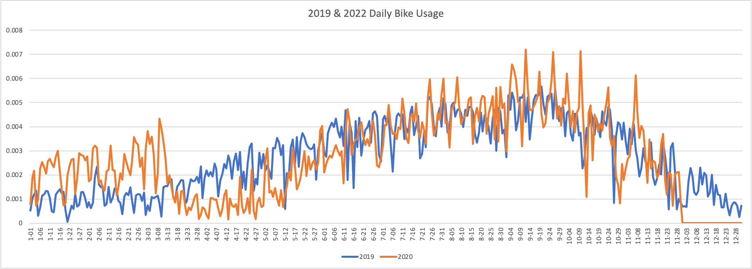
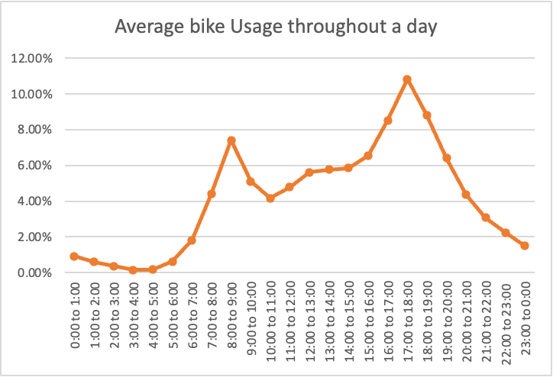
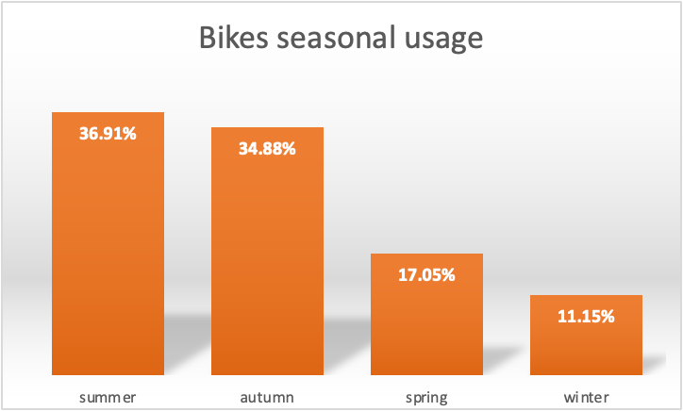
Yuanchun, Hua, Isaac
Exploratory Analysis / Summary Statistics – 2/5
From Yearly Perspective
Based on the trend analysis of 2019&2020 daily bike usage, the demand of bikes increased during summer and fall.
From Daily Perspective
The average bike usage peaks around 7:00a.m-8:00a.m in the morning and 17:00p.m to 18:00p.m at night.
From Seasonal Perspective
Apparently, bikes utilization is high during summer and autumn, and it decreases a lot in spring and winter.

Slide 7
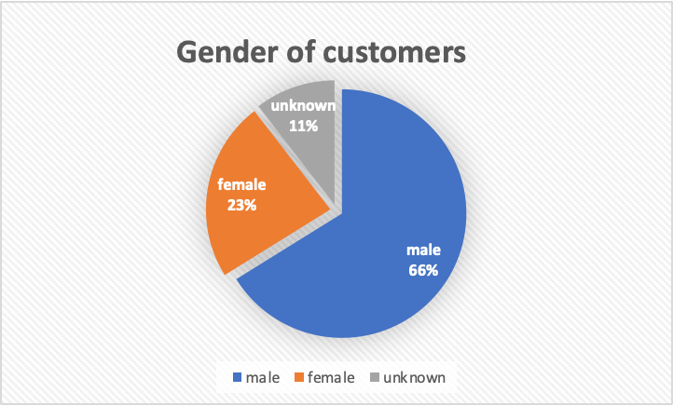
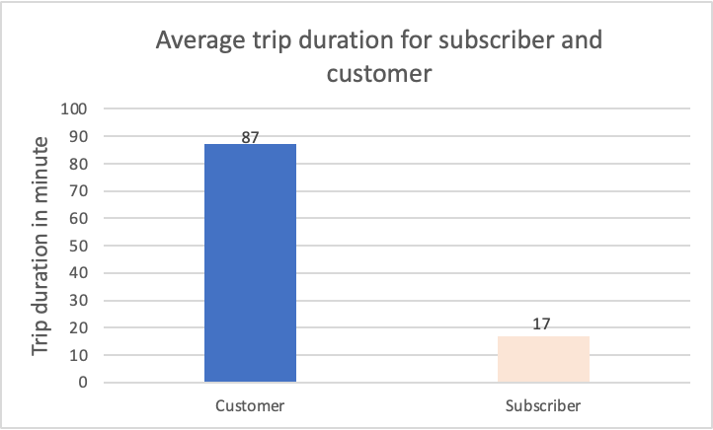
Yuanchun, Hua, Isaac
Exploratory Analysis / Summary Statistics – 3/5
Based on our discoveries, the number of male customer group is predominant compared to female group.
Average trip duration for subscriber is about 17 minutes. This indicates that subscribers might be group of people who ride bikes to work frequently with short distance.
In adverse, average trip duration for customers is much longer and lasts about 87 minutes which indicates less frequent use.

Slide 8
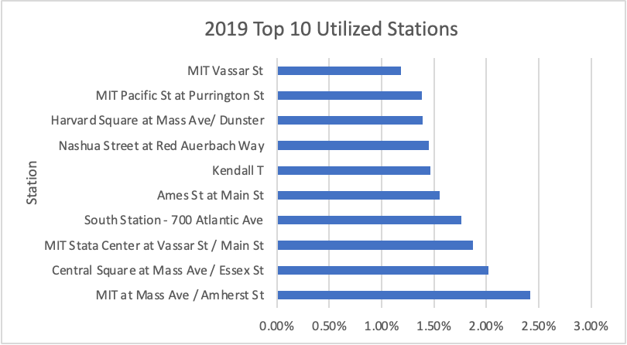
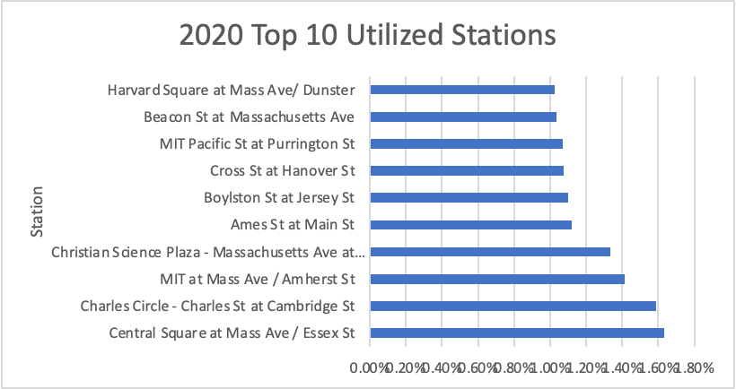
Yuanchun, Hua, Isaac
Exploratory Analysis / Summary Statistics – 4/5
The bustling stations in 2019 and 2020 are listed in the graphs below.
In both years, MIT at Mass Ave/Amherst St. and Central Square at Mass Ave/Essex St. rank at the top.

Slide 9
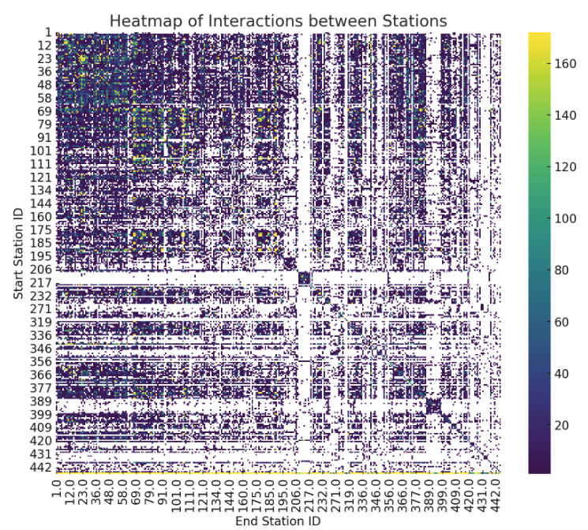
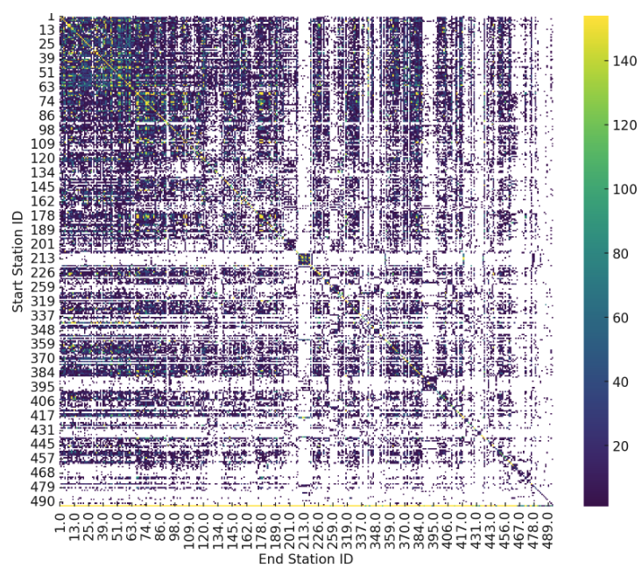
Yuanchun, Hua, Isaac
Exploratory Analysis / Summary Statistics – 5/5
Bike usage at different Start-end stations:
The interaction between bike stations in year 2019:
The interaction between bike stations in year 2020:

Slide 10
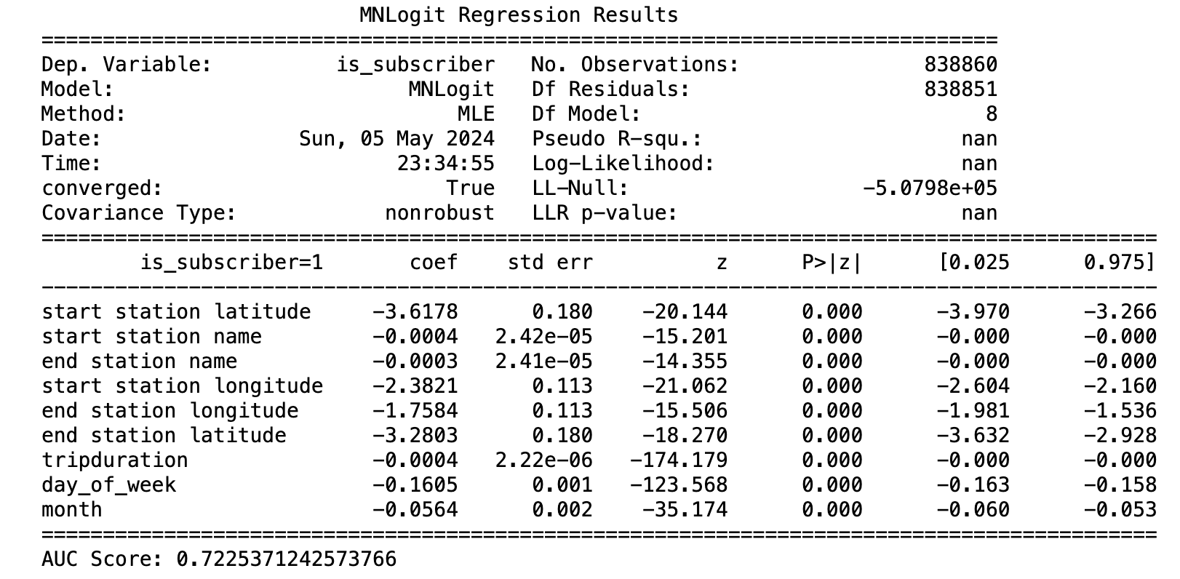
Multinomial Logit Model Output
Joeseph

Slide 11
Exponential Smoothing / Holt-Winters Output
John
John

Slide 12
Capacity Optimization – MIT at Mass Ave / Amherst St (id: 67)
Patrick
The Following Metrics Were Calculated Using The "NORMAL DIST MODEL.py" Script For The Busiest Station in 2019
Demand Characteristics
Performance Metrics (0.95 Service Level)
Cost Parameters (0.95 Service Level)
Mean Inflow per day | 191.0549
Standard Deviation of Inflow per day | 38.36096
Mean Outflow per day | 199.1319
Standard Deviation of Outflow per day | 39.52811
Mean Net Demand | -8.07692
Standard Deviation of Net Demand per day | 55.08207
Time Period (# days before each restock) | 1
Safety Stock (0.95 Service Level) | 82.53309
Probability of NO stockouts | 0.95
Probability of at least one stockout | 0.05
Corresponding Z-Score | 1.64
Standard Normal Loss Function L(z) | 0.0916
Expected Lost Sales | 5.04308
Expected Sales | -13.12
Expected Excess Inventory | 95.65309
Holding Cost (1 Unit) | $1
Stockout Cost * | $12.95
Cost of excess inventory | 95.65309
Cost of lost sales | 65.30788
Total Cost | 160.961
* Based on average cost per ride for given time *.period + $10 goodwill cost

Slide 13
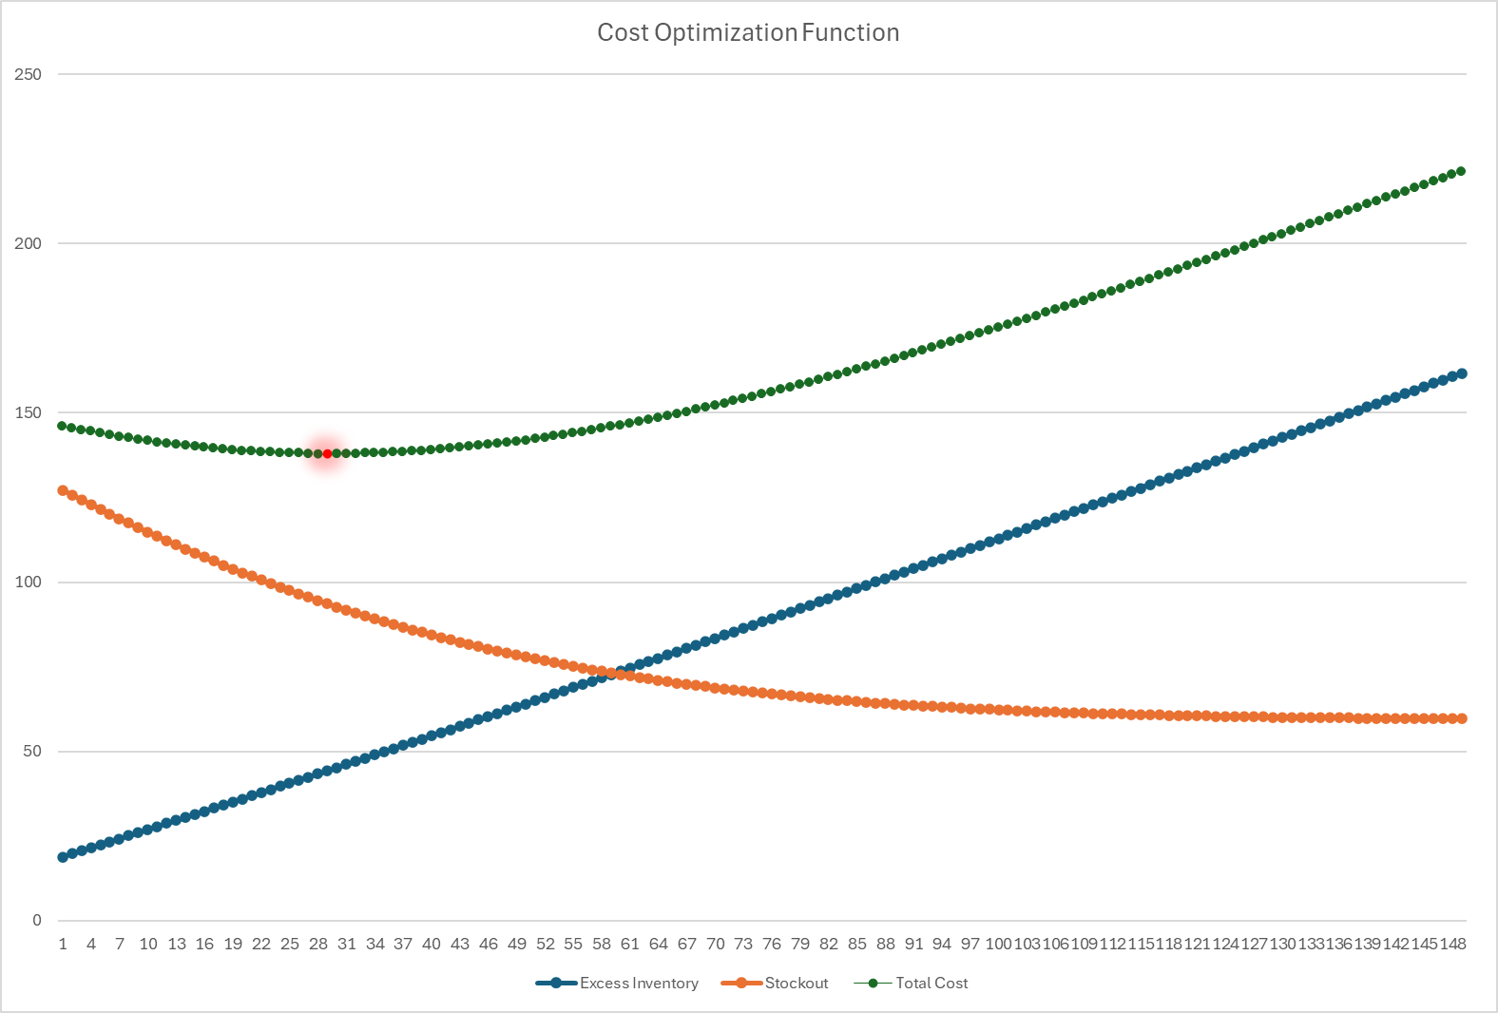
Capacity Optimization – Normal Distribution Model
Patrick
Solver Output
OBJECTIVE: Minimize Total Costs
DECISION VARIABLE: # of Bikes to Stock
Solver found that the optimal number of bikes to stock at the beginning of every day in order to minimize total costs is 29 units. With a beginning inventory of 29 each day, the "MIT Mass Ave. / Amherst" Station has a predicted service level of ~ 0.75 meaning that there is a 25% chance of stockout. At this service level, the predicted costs are as follows:
Cost of excess inventory: 44.3073
Stockout cost: 93.63339
Total Cost 137.9407
According to BlueBikes, the current # of docks at the "MIT Mass Ave. / Amherst" Station is 27 bikes. Therefore, we recommend increasing this to 29 bikes, and fully restocking every morning.
*.

Slide 14
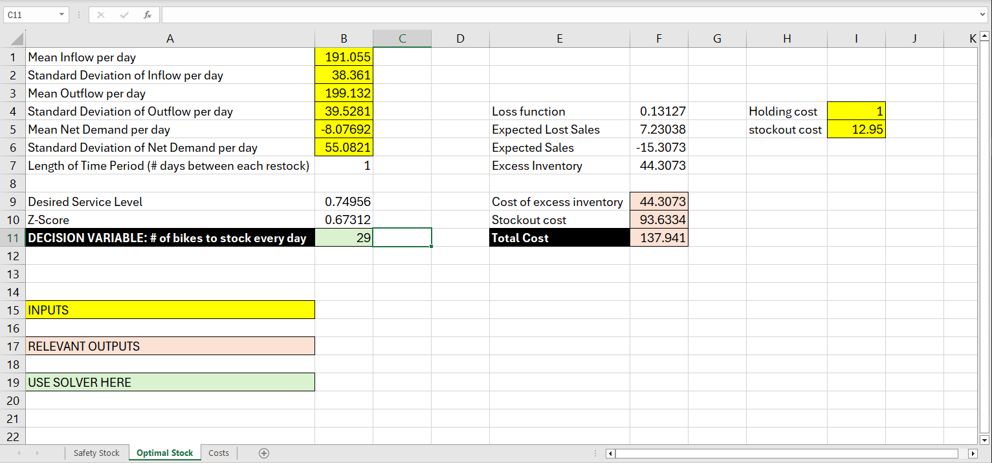
Capacity Optimization – Moving Forward
Patrick
Recommendation
Use the decision tool we have created to find optimal daily stocking level to minimize cost for every active station. In order to do this, please run our python script "NORMAL DIST MODEL.py" and replace the "station id" value in the code with the id of your desired station. Then, take these calculated values, input them in the "Optimization" sheet (AKA our decision tool) and run solver to find optimal quantity of bikes to stock for every station.
*.

Slide 15
Conclusion
Isaac, Estelle, Jean
1. Exploratory Analysis
Our exploratory analysis addressed a wide variety of key insights, including bike-sharing trends surrounding trip activity, peak usage during certain commute hours / seasons, user demographics and patterns among different groups.
2. Multinomial Logit Model Output
After model development, we achieved an AUC score of 0.72. This score indicates that the combination of features in our model, namely 'start station latitude', 'start station name', 'end station name', 'start station longitude', 'end station longitude', 'end station latitude', 'trip duration', 'day of the week', and 'month', plays a significant role in determining whether an individual is a subscriber.
3. Exponential Smoothing / Holt-Winters Output
[to be updated]
4. Capacity Optimization
Using a normal distribution model, we were able to determine an optimal stocking level of 29 bikes per day at the MIT Mass Ave / Amherst station. We were able to achieve a service level of 75%, while also minimizing the total costs of excess inventory and stockouts.
We can use the method we created here to optimize daily stocking level for every station moving forward to minimize costs across the board.
Joeseph
John
Patrick

